Slide 2
Presentation on ا ر د و گر امر Presented by
DR. Sabiha Sayyad From Night College of Arts and Commerce ,Ichalkarnaji. Urdu Department

Slide 6
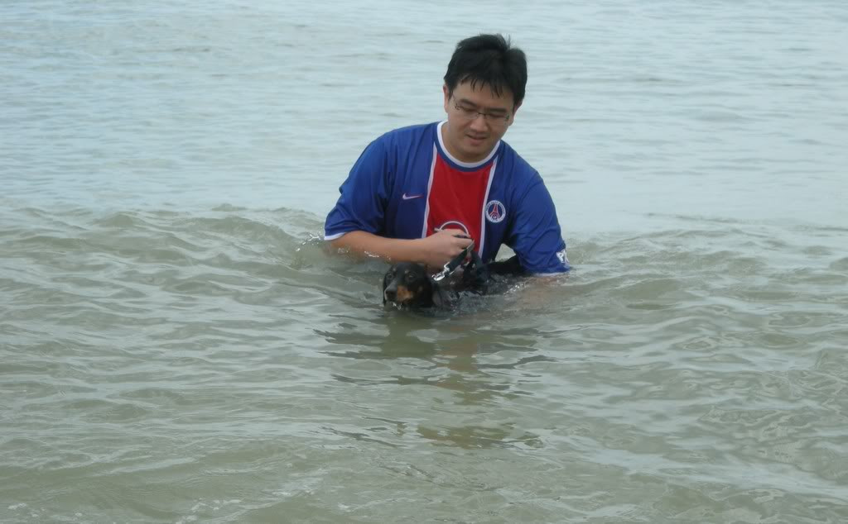

Slide 8
شکریہ

